Slide 1
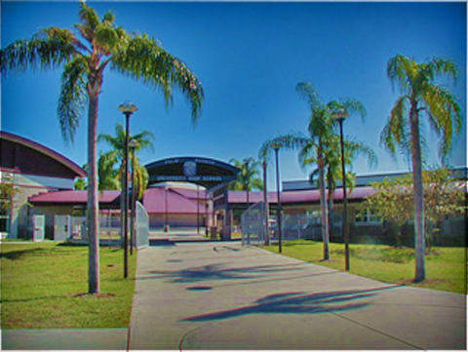
Class of 2025
Seminar
UNIVERSITY COUNSELORS
Jeannine Miller: A-C
Amanda Madej: D-M
Tim Papp: N-Z

Slide 2
ACADEMICS/RESPONSIBILITY
YOUR FUTURE IS NOW
BE INFORMED
Our Primary Goal
For You Today
To gain awareness and knowledge of ALL specific requirements related to: GRADUATION REQUIREMENT | To gain awareness and knowledge of ALL specific eligibility requirements needed to qualify for: BRIGHT FUTURES SCHOLARSHIP | To gain awareness and knowledge of the academic expectations accumulated over 4 years in high school: NOTABLE 4 YEAR UNIV/COLLEGE ADMISSIONS CRITERIA

Slide 3

GRADUATION REQUIREMENTS
CLASS
OF
2025

Slide 4
CORE GRADUATION REQUIRMENTS
24 credits/2.0 unweighted G.P.A.
SUBJECT | GRAD REQ | ASSESSMENT REQ UIREMENT
English | 4 English | Must PASS the Grade 10 FSA ELA assessment
Math | 4 credits total to include 1 credit Algebra 1 1 credit Geometry | Algebra 1 EOC MUST PASS Geometry EOC results count 30% of the final course grade
Science | 3 credits total 1 credit in Biology 1 2 credits in equally rigorous science | Biology EOC results count 30% of the final course grade
Social Studies | 1 credit in world History 1 credit in U.S. History .5 credit in U.S. Govt .5 credit in Economics | U.S. History EOC results count 30% of the final course grade
World Language | Not required for H.S Graduation | 2 Sequential Years Required for Admission into state universities To meet Bright Futures Scholar Criteria
Fine Arts | 1 credit in Fine Arts | Also considered: some practical arts such as DIT and Journalism
PE | 1 credit in HOPE | Health Opportunities in Physical Education
Online | 1 online credit | Take one full class online

Slide 5
ELA/END OF COURSE
ASSESSMENTS
STUDENTS NEED TO BE AWARE THAT THESE TESTS ARE TIED TO STATE GRADUATION REQUIREMENTS AND ARE NECESSARY TO PASS IN ORDER TO EARN HIGH SCHOOL DIPLOMA
NOTE:
YOU WILL BE PLACED IN A STATE MANDATED ELECTIVE COURSE FOR SUPPORT IF YOU DO POORLY OR IF YOU FAIL TO TAKE THE TEST AT ALL.

Slide 6
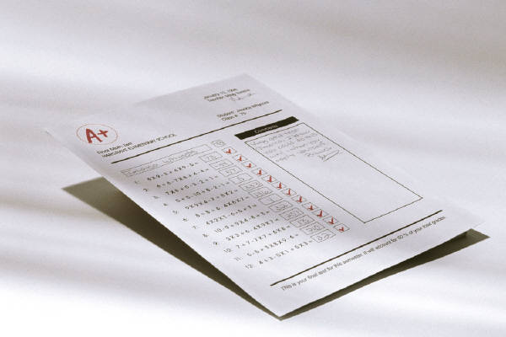
ACADEMIC PROGRESS

Slide 7
GRADING SYSTEM
QUESTION | ANSWER
What do I earn for passing a class? | .5 credit per semester Credit earned in any class you receive a “D” or higher as your final grade (per semester)
How many credits can I earn in one year of high school? | 3.5 credits are possible per semester = 7.0 credits per year (if all classes passed )
How are final grades calculated? | Two grading periods per semester plus a final exam (if not exempted) are averaged together to calculate final semester grade
What is the Exemption Policy? | Is Attendance and Grade driven See School Website for Criteria
1ST
2ND
FINAL
EXAM
FINAL

Slide 8
MYTH vs. FACT
As long as I just get by with doing as little as possible and pass all my
classes with a “D,” I will be able to fulfill all my requirements to graduate. -- MYTH
FACT: It is not easy to simply raise a low GPA
SEE FOLLOWING SLIDE
Notice how difficult it is for student to improve GPA.
This example is to illustrate how difficult it is, even for a relatively decent student who earns just one “D”, to get cumulative GPA above 3.0.

Slide 9
4 YEARS OF HIGH SCHOOL PROGRESSION
IT IS NOT EASY TO RAISE YOUR GPA
9th GRADE English A Math B Science C AmGvt B For. Lang D Elective B GPA- 1st semester= 2.67 GPA- 2nd semester =2.67 CUM GPA= 2.67 | 11th GRADE English B Math B Science B AmHist B Art B Elective A GPA- 1st semester=3.16 GPA- 2nd semester=3.16 CUM GPA=2.94
10th GRADE English A Math B Science B WHist B For. Lang C HOPE B GPA – 1stsemester=3.0 GPA – 2nd semester=3.0 CUM GPA=2.83 | 12th GRADE English A Math B Science B Economics A Elective A Elective A GPA- 1st semester=3.67 GPA- 2nd semester=3.67 CUM GPA=3.12

Slide 10
DEFINE YOUR ACADEMIC/PERSONAL OBJECTIVES
YOUR academic objectives in your approach to school SHOULD consist of:
** Develop and maintain a disciplined homework/review/study schedule
** Continuously seek to grow as a student through :
    Improved Work Ethic
    Increased Effort
    Attention to Detail
YOUR personal objective, as related to both academic and personal growth, must focus on the following while in your high school years:
** Become Increasingly More RESPONSIBLE
** Learn to ADVOCATE for yourself
** Learn how to MANAGE and overcome difficult situations
** Develop a sense of ACCOUNTABILITY for both the good and bad

Slide 11
ATTENDANCE POLICY
QUESTION
What are my expectations if I am going to miss school?
ANSWER
In order to be marked as EXCUSED -- your Parents must submit either a:
NOTE EMAIL REPORT ON WWW. PCSB.ORG/PHUHS PHONE CALL must be submitted to grade level secretary | ASK For 9th Grade Clerk, Ms. Redfield (727) 669-1131 ext. 2036

Slide 12
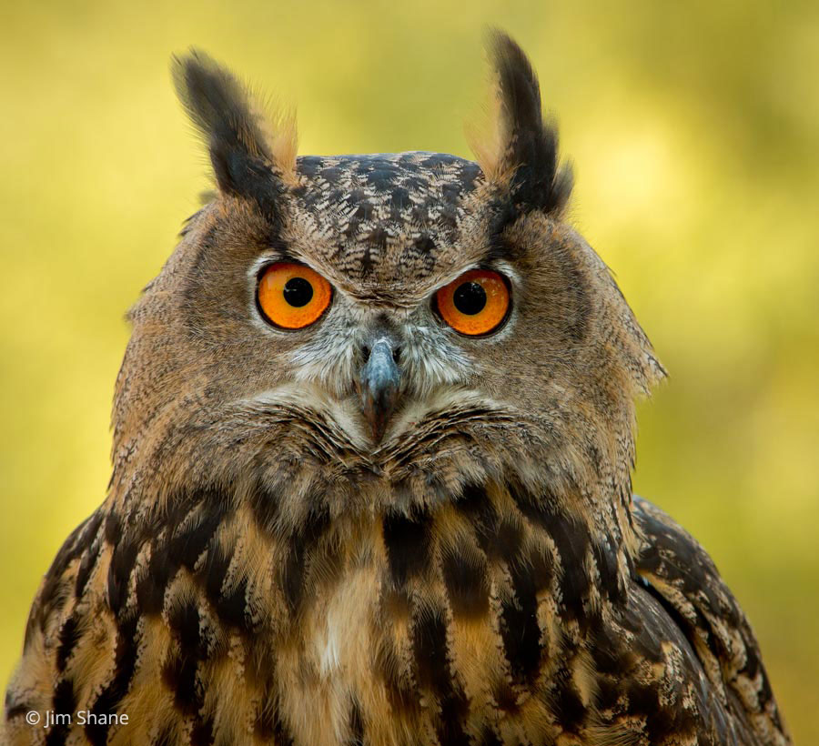
COLLEGE ACADEMIC EXPECTATION
This Photo by Unknown Author is licensed under CC BY-SA-NC

Slide 13
COLLEGE/UNIVERSITY
CRITERIA
Seeking Well-Rounded Student w/ Major Emphasis on the “Big Three”
THE BIG THREE | SPECIFIC REQUIREMENTS | HIGH SCHOOL GPA
HIGH GPA RIGOR OF CURRICULUM HIGH SAT/ACT SCORES | MATH (Algebra II)* FOREIGN LANG (2 Years)* * Minimum Requirements | ALL State Universities 3.3 High School GPA or above of all incoming Freshman College Students Grades earned in 9th grade are vitally important in earning a competitive GPA (3.0 on low end of competitive.

Slide 14
Naviance
Naviance is a customizable planning portal for students and families including self-discovery assessments, goal-setting, college research tools, and career exploration resources.
On Naviance, you can take a career interest inventory, complete a resume, search for colleges and explore a variety of post-secondary options.
Introductory Naviance video: https://www.screencast.com/t/tbcYt9eUkKg
Logging into Naviance
  Log into Clever and select the Naviance icon. You can also type “Naviance” into the search bar.
  Once you are in Naviance, scroll down to see your “Important To Dos and Tasks” and begin working on those. You can also click on “Planner” in the top tool bar and select “Tasks” to see what is required for you to work on.

Slide 15
Naviance Tasks
Transition to High School Survey
4 Year Plan Review
Understanding My Personality Type and How It Connects to My Post-Secondary options
  These tasks will provide a reminder of Naviance, its purpose, and how they will use it throughout the course of their high school career. Students will identify their thoughts and feelings about transitioning to high school.

Slide 16

BRIGHT FUTURES
http://www.floridastudentfinancialaid.org/SSFAD/bf/

Slide 17
BRIGHT FUTURES
SCHOLARSHIP
ACADEMIC | MEDALLION | GOLD SEAL
3.5 | 3.0 | 3.0/3.5
SAT: 1330 ACT: 29 | SAT: 1210 ACT: 25 | SAT: 24R, 25W, 24M ACT: 17E, 19R, 19M PERT: 106R, 103W, 114M
100 Hours/Comm Service | 75 Hours/Comm Service | 30 Hours/Comm Service/ 3 classes tech program
SERVICE LEARNING PROJECTS MUST BE PRE-APPROVED BY SCHOOL COUNSELOR PRIOR TO VOLUNTEERING OR EARNING HOURS TOWARDS BRIGHT FUTURES REQUIREMENTS
 | SEE WEBSITE FOR MORE INFO:
http://www.floridastudentfinancialaid.org/SSFAD/bf/

Slide 18

PLANNING
Beyond 9th grade
This Photo by Unknown Author is licensed under CC BY-SA

Slide 19
COLLEGE PROGRAMS
FOR HIGH SCHOOL STUDENTS
LOOKING FORWARD TO
JUNIOR/SENIOR
YEAR
PLAN AHEAD/BECOME KNOWLEDGEABLE
HIGH SCHOOL PROGRAMS ONLY AVAILABLE FOR 11TH/12TH GRADE STUDENTS Dual Enrollment (up to 3 classes at SPC)* Early College (FT SPC in 11th/12th) Early Admission (FT SPC in 12th ONLY)

Slide 20

Dual Enrollment
Earn college credits for free!
St. Petersburg College offers college classes to qualified high school students in Pinellas County at no charge! These courses give students credits toward a high school diploma and a college degree. Courses are available on SPC campuses and some local high school campuses.
What's required to enroll
3.0 unweighted cumulative GPA
Satisfactory scores on the College Placement Test (PERT) or SAT/ACT.
Obtain the signature of the high school principal on the Permission form Dual Campus Coursework form indicating the student is prepared for the dual enrollment experience.
TO RESEARCH FURTHER:
https://www.spcollege.edu/future-students/admissions/high-school-programs

Slide 21
Early College Program
Earn college credits for free!
A unique partnership between St. Petersburg College and Pinellas County Schools
The Early College Program offers college credit hours as well as high school credit at no cost to highly motivated students in grade 11. Earn as many as 60+ credits towards a 4-year bachelor's degree through participation in the Early College Program.
Who is eligible?
Students entering grade 11
What's required?
A 3.0 unweighted cumulative GPA or higher.
Satisfactory scores on the College Placement Test (CPT/PERT) or SAT/ACT.

Slide 22
Early Admissions
Start college early - for free!
St. Petersburg College offers early college admission to qualified high school students in Pinellas County at no charge! This program gives students credit toward a high school diploma and a college degree.
Earn as many as 30+ credits towards a 4-year bachelor's degree through participation in the Early Admission Program.
Who’s eligible?
Pinellas County students who have completed three years of high school with a minimum of 18 credits earned and who have achieved an acceptable score for college-level courses on the SAT, ACT, FCAT or SPC College Placement Test (including math). There is no cost for application, tuition or textbooks.
What’s required to enroll?
Student must:
See their guidance counselor to verify that they are eligible.
Spend their senior year as a full-time SPC student.
Have at least an unweighted cumulative GPA of 3.0 on a 4.0 scale (unweighted) for all high school work attempted.

Slide 23


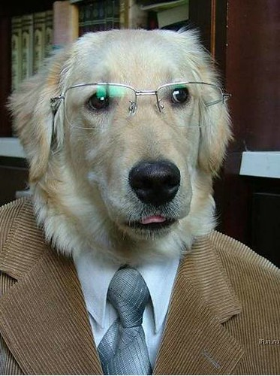
TUTORING
OPTIONS
This Photo by Unknown Author is licensed under CC BY

Slide 24
TUTORING RESOURCES
SEEK HELP WHEN YOU NEED IT
If you need help or have a question, always start first with your teacher!!!
Could you benefit from additional help? Take advantage of the FREE tutoring resources we have to offer!!!
Tuesday and Thursday 2:15-4:15
  Math: Alg 1 → 19-123; Geo/Alg 2 → 19-103; Trig/Precal/etc → 19-113
Homework Help Line
  727 547 7223
  Monday – Thursday 5:00pm-8:00pm
  To seek referral for PAID Tutors, See Counselor

Slide 25
ACADEMIC ASSISTANCE
Online Resources
The Khan Academy
http://www.khanacademy.org/
Math Nation
https://www.mathnation.com/
Pinellas County Web Resources
https://www.pcsb.org/homeworkhelp
Pinellas Ecounselor
ecounselor@pcsb.org (M-F 4-9pm)

Slide 26

Freshman/Sophomore Parent Night
  November 10th 5:30-6:30pm Virtually (TEAMS)

